Slide 1

Gooseplayer A music player for DnD & Data Enthusiasts & Local Music Server Streaming
Joshua Anderson
&
Camillus Settanni

Slide 2
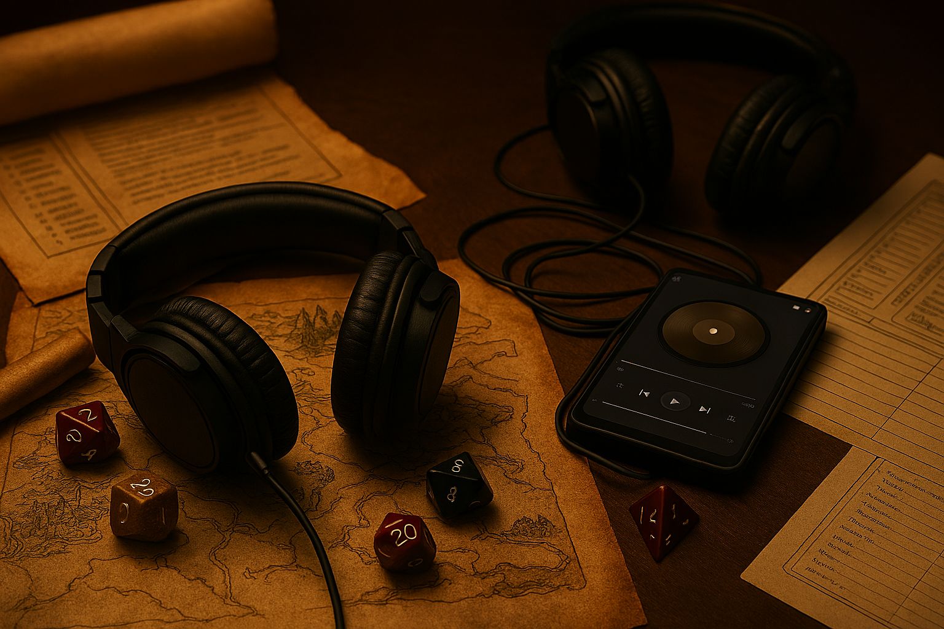
What is GoosePlayer?
GoosePlayer is a Windows computer desktop application that allows for multiple music tracks to be played in conjunction with each other, allowing for a much more immersive environment when playing table-top games such as Dungeons and Dragons (DnD). GoosePlayer also allows for connection to a remote music server giving users the ability to stream their audio remotely through the player.

Slide 3

Analysis for Gooseplayer

Slide 4
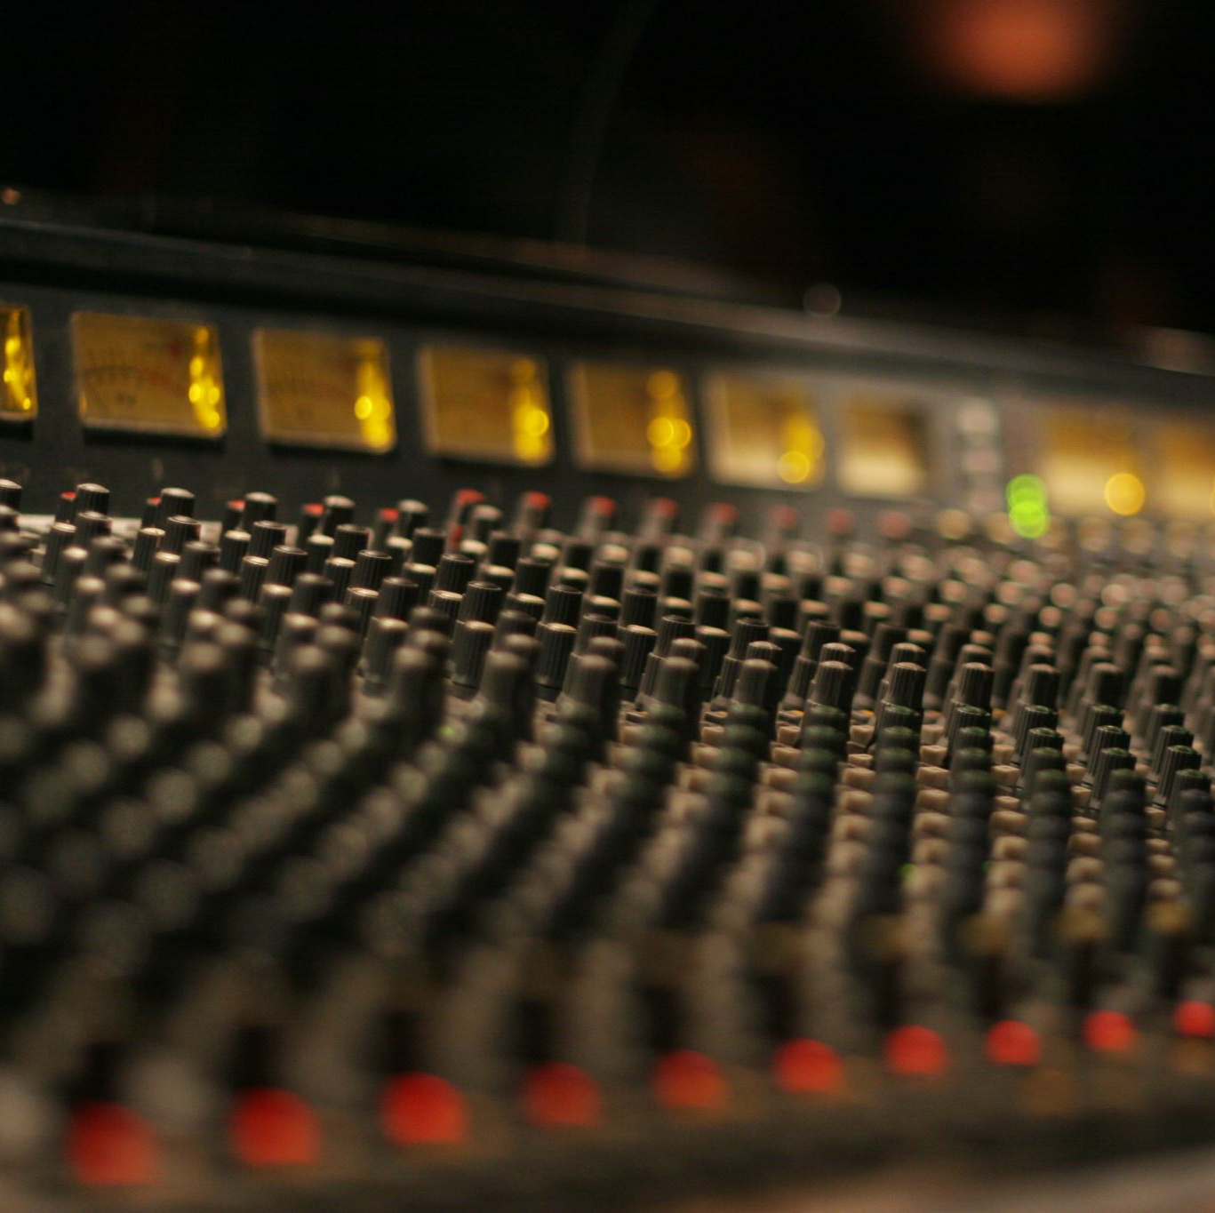
Why Gooseplayer? This music player was born out of three specific reasons.
Market Gap
Lack of mainstream music players capable of simultaneously playing multiple tracks for DnD sessions (ex. Windows Media Player, VLC, Foobar2000)
Architectural Learning Goal
Wanted to link a network music server with the application, demonstrating networking concepts such as the client-server architecture
Technical Learning Demonstration
Desired to code an advanced desktop application for Windows implementing concepts such as queuing for files and using advanced coding tools and features available in Java

Slide 5
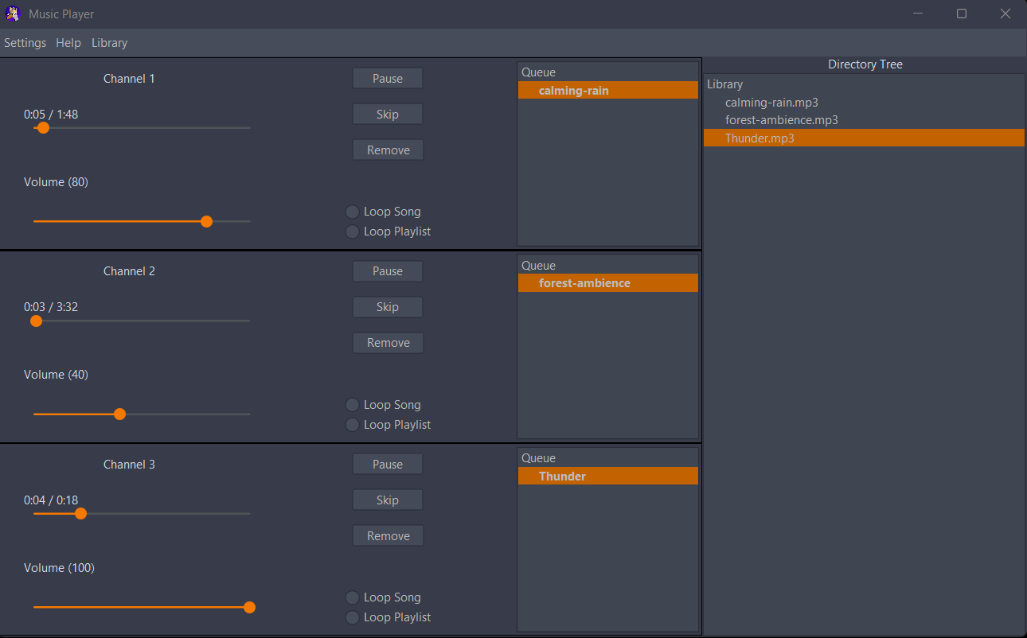
Where the Demand for Gooseplayer Exists
Dungeon Masters need multiple ambient sounds ( ex. rain + distant thunder + combat music) playing simultaneously with independent volume and fade control to set the desired ambience for a game
Existing tools force DMs to either: use multiple browser/ media player tabs OR pay for services with someone else’s sound packs and application.
Gooseplayer gives full overlapping playback capability and works 100 % offline offering a clean interface
Live Demo example

Slide 6
Requirements Overview
Functional and Non-Functional Requirements

Slide 7
GoosePlayer System Requirements & Features
Functional Requirements (Must-Have)
Play, Pause, Skip, Remove, Clear, Repeat One, Repeat All, and Shuffle functions
Seek with clickable progress bar
Queue persistence - Remember previously queued tracks
Independent volume & fade per track for each player instance in Multi-player mode
Multiple simultaneous tracks (true overlap)
Drag-and-drop music files/folders into queue
Functions correctly mapped to buttons
Streaming from private server
Support for MP3, WAV, FLAC formats
Offline player capability (Main Player and Multi-Player Modes)
Non-Functional Requirements
Display title, artist, album, year, genre
Show embedded or folder album art + placeholder
Double click to play
Play All and Stop All functions and buttons for Multiplayer
Adjustable drag and arrange in player queue
UI facelift

Slide 8
GoosePlayer Architecture/ Design

Slide 9
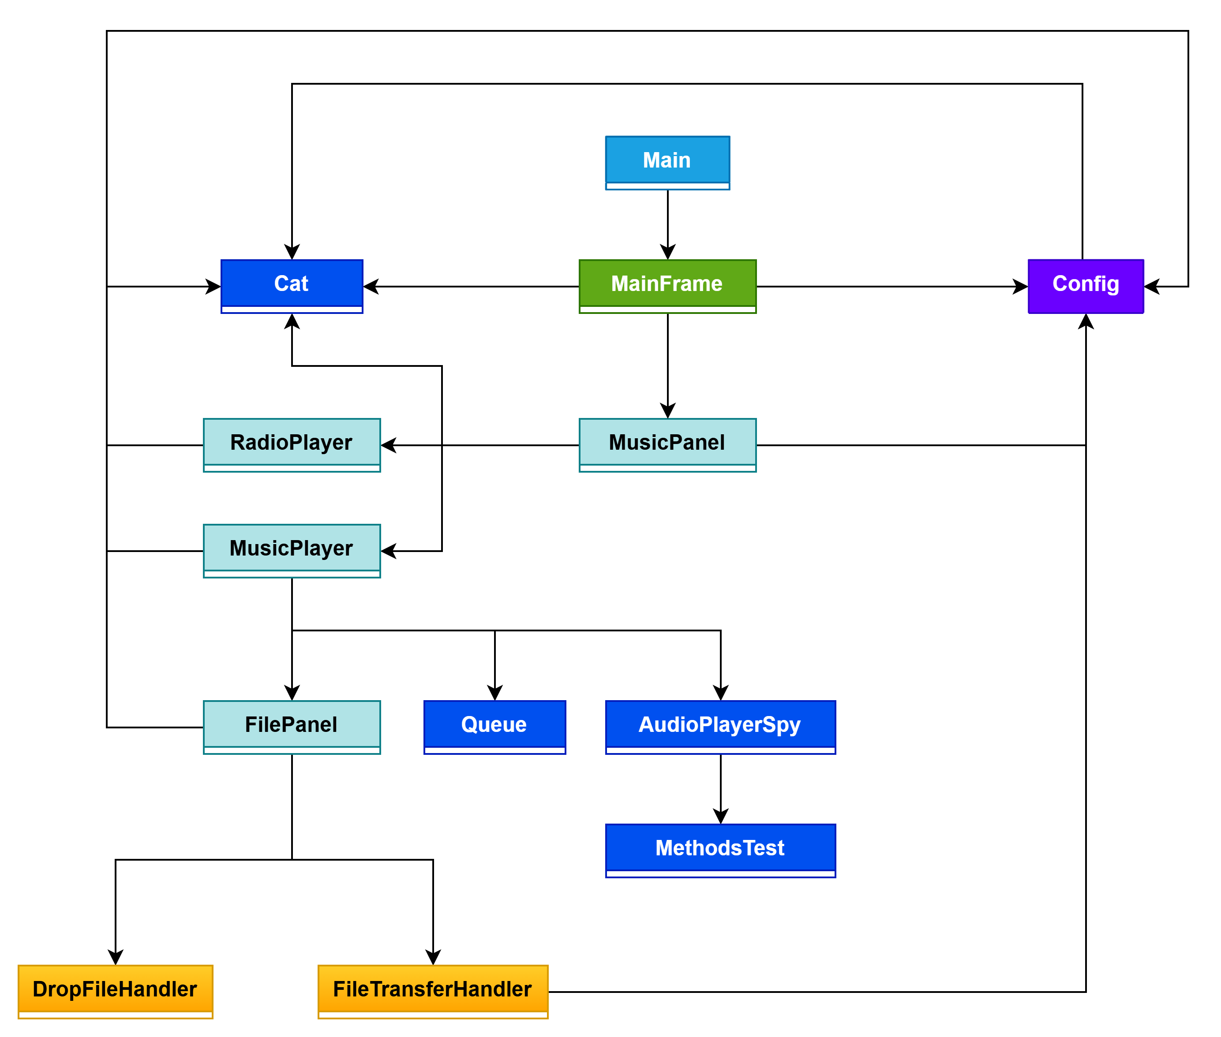
Design & Architecture
Hierarchical Class Diagram

Slide 10
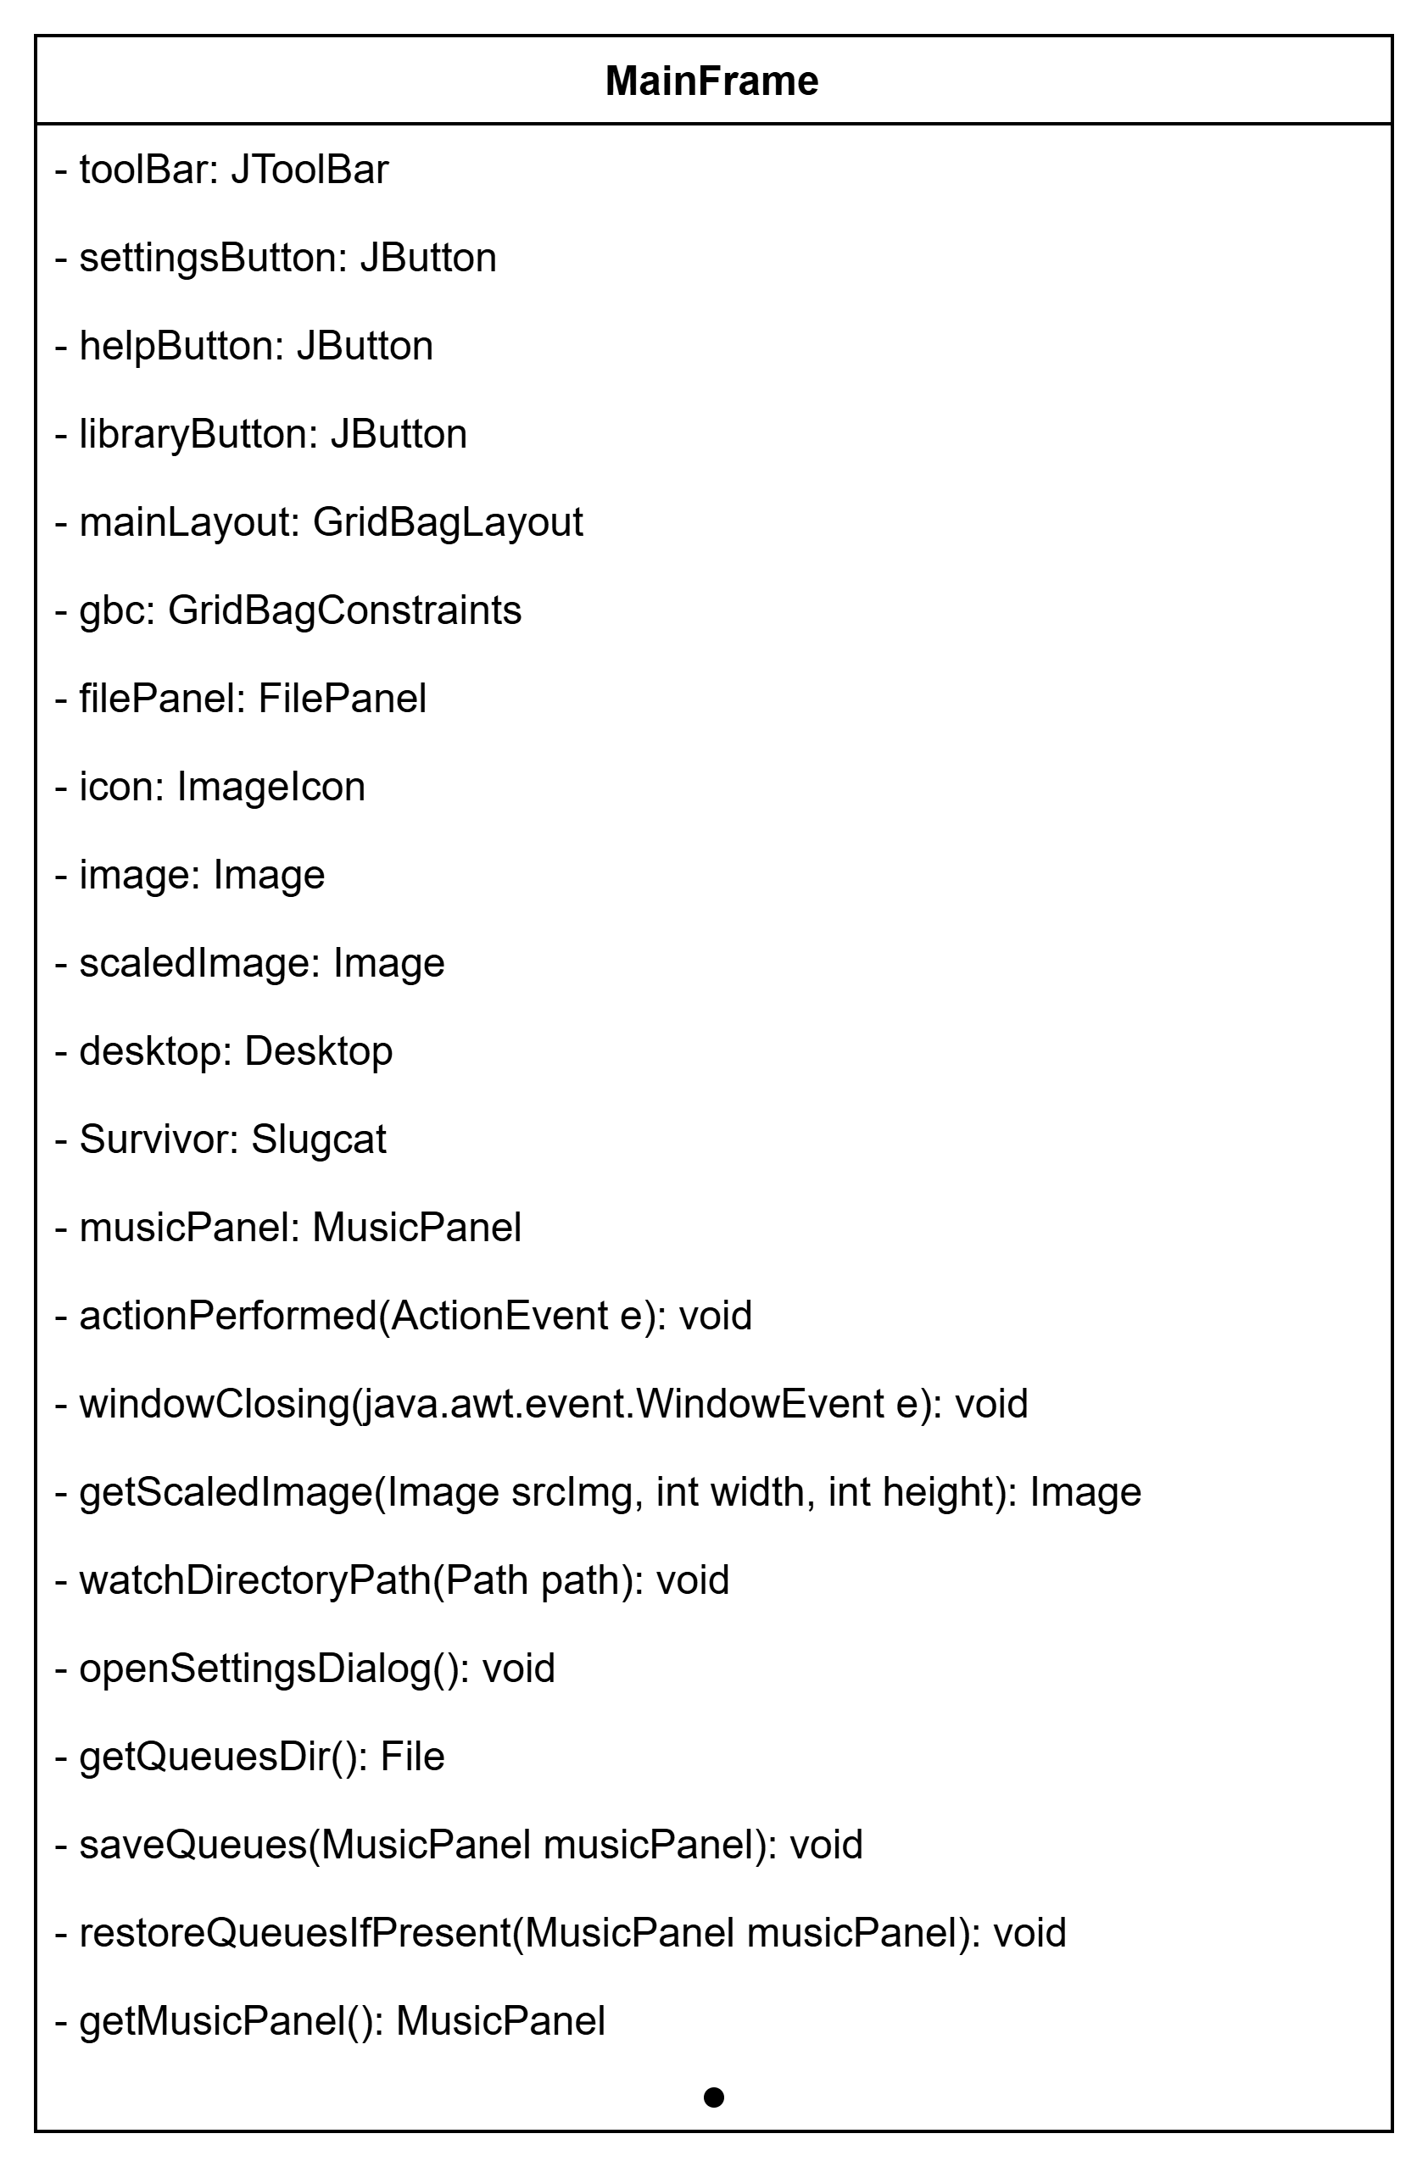
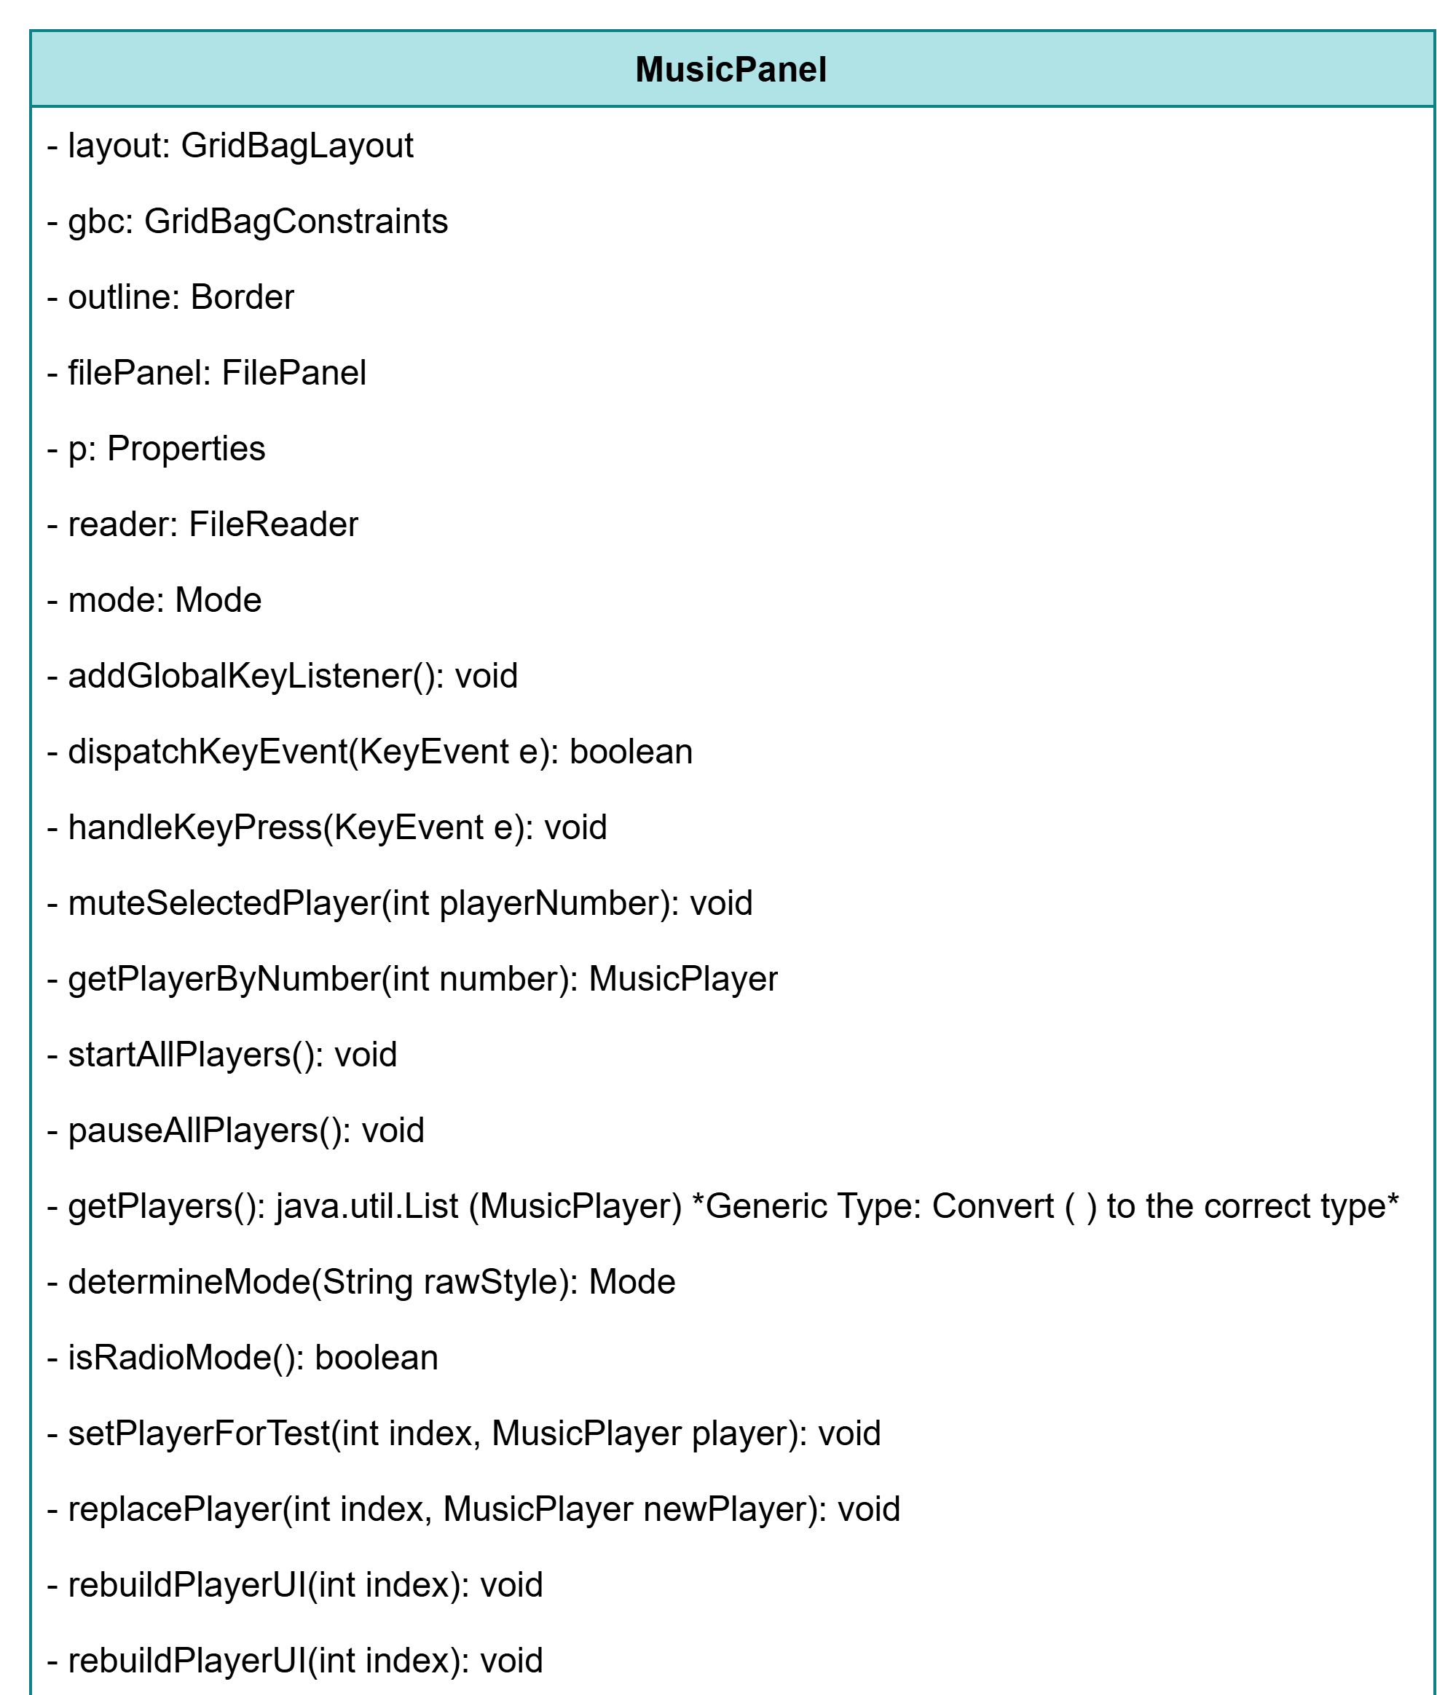
GoosePlayer UML Diagrams

Slide 11
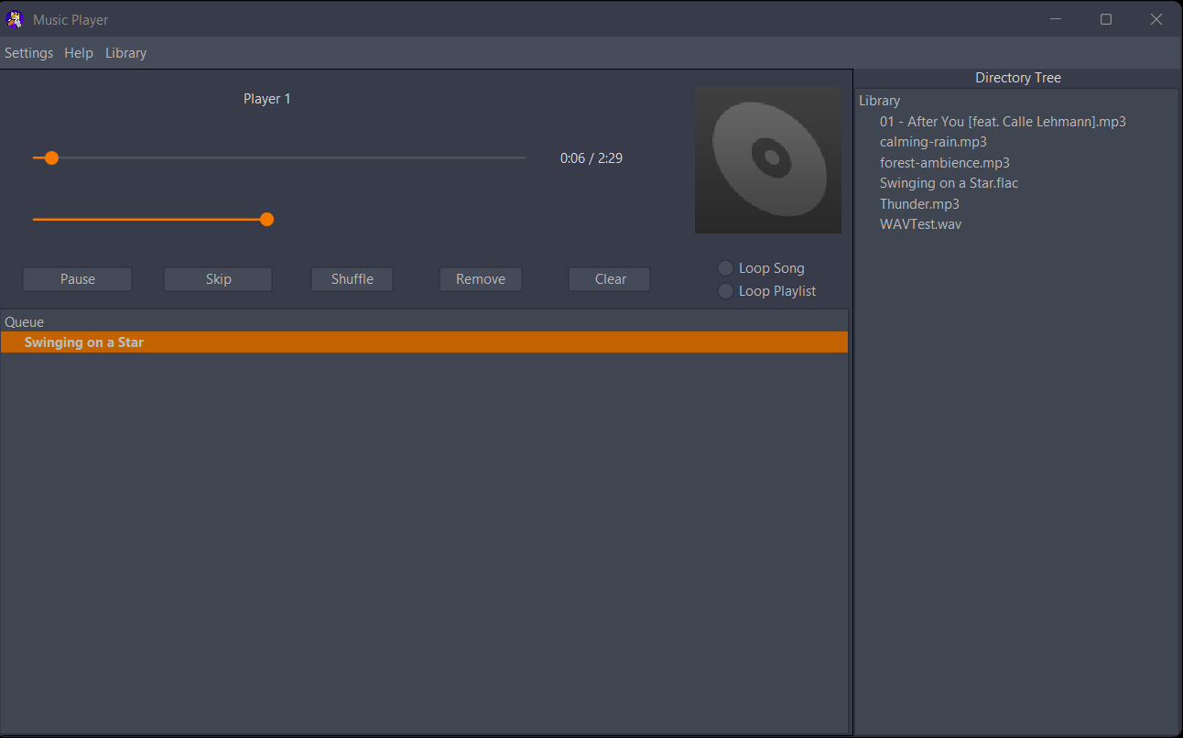
UI Design
Java Swing was limited with its customization offering
Flatlaf + IntelliJ themes improved on Swing giving a much newer style

Slide 12
Implementation Approach
Agile/Scrum with 1-week sprints
Weekly progress reviews and sprint planning – focus on backlog, features, and testing

Slide 13

Tools/Technology Used for this Project
Language
Project Management/ Communication
Version Control
Grok
Copilot
IDE
Build Tool
Java
Apache Maven
VS Code
Git
Github
Discord
Jira
AI assistance
ChatGPT
Diagram Software
Draw.io

Slide 14
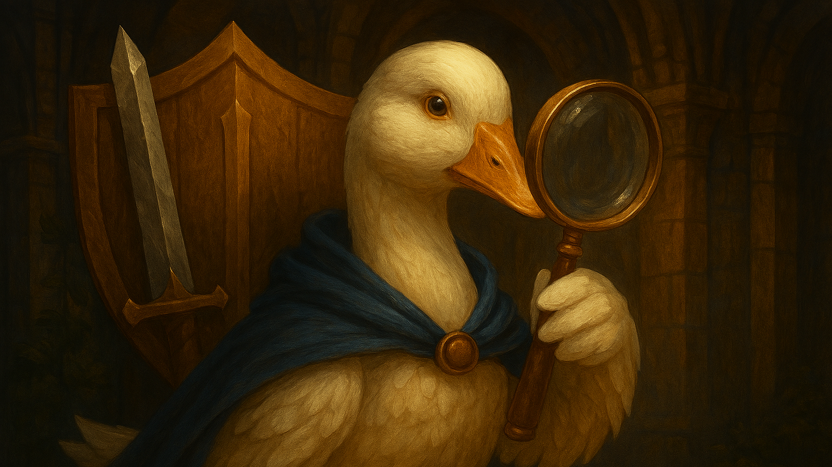
Testing

Slide 15
Testing Tools Used
JUnit 5
Main assertion and testing framework
Mockito
Object Mocking framework for Java
AssertJ swing (tokyo.northside fork)
UI testing component

Slide 16
Test Cases
Mix of manual and automated regression testing covering:
- Methods being called
And functioning when called
-Cyclomatic Complexity for core functions
- UI interactions both manual and automated
- Queue interactions

Slide 17
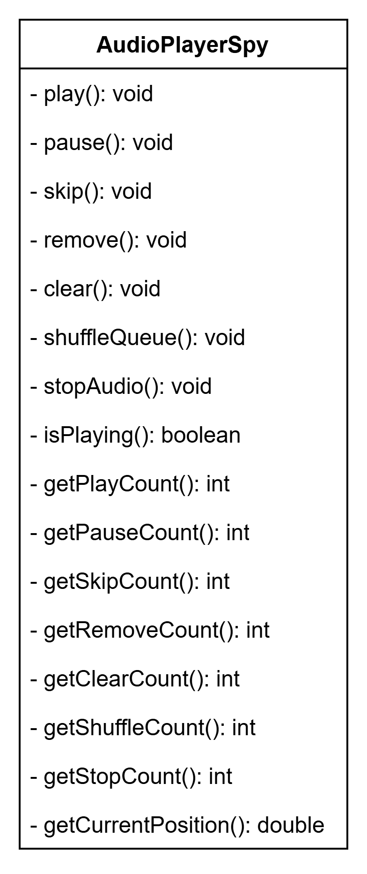
Testing Focus Areas
Focused on testing the core functions of the Music player
Covered the Play, Pause, Skip, Remove, Clear, and Shuffle functions ensuring Functional Requirements for the player were successfully implemented
46 Regression tests using Junit and AssertJ-Swing
Verified exact method invocation counts using Spy objects
UI Automation: tests included Dragging-and-dropping files into a queue, clicking on GoosePlayer buttons, and error handling

Slide 18
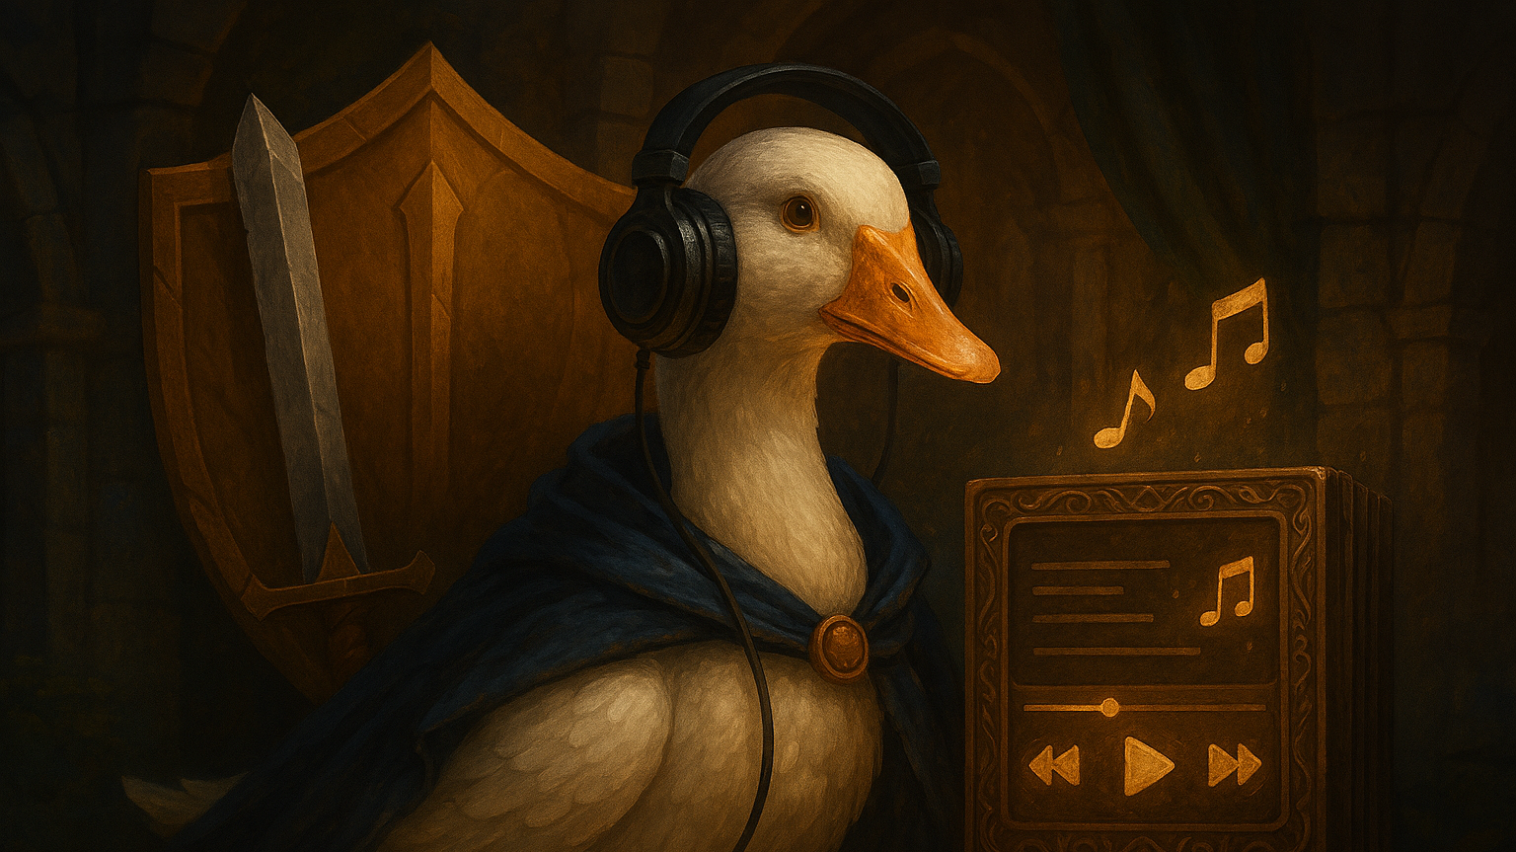
GoosePlayer Demo

Slide 19

Future Features for Implementation

Slide 20
Project Challenges
Maven Library Navigation
Radio Plugin Support
Testing Software

Slide 21

Questions?

